Slide 1
HOBO based rugosity indices
Achziv & Sdot Yam 45m depth sites

Slide 2
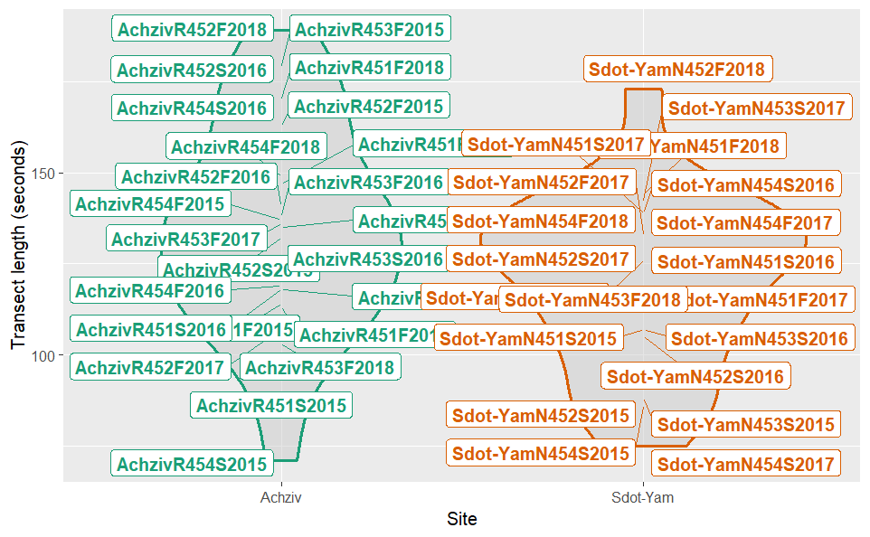
The data

Slide 3
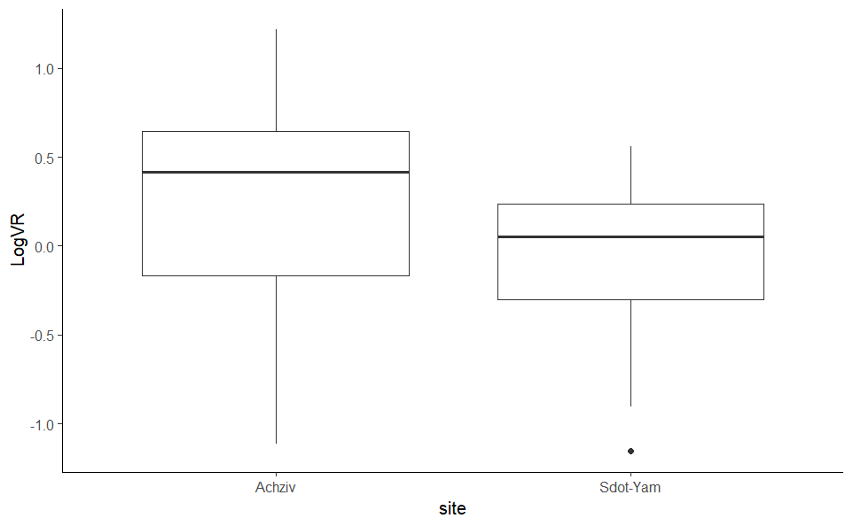
Vertical Relief: the difference between the deepest and shallowest measurements in the bottom profile

Slide 4
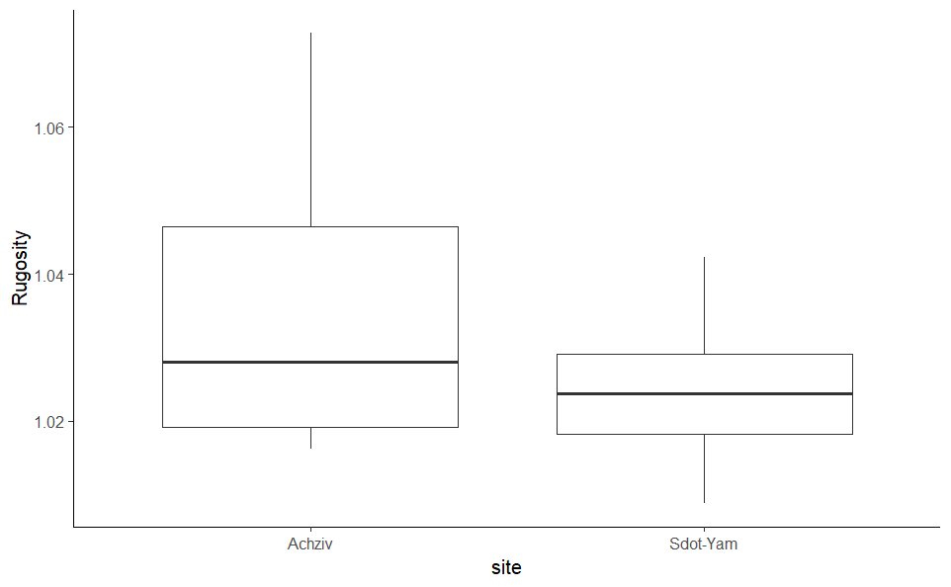
Rugosity: the ratio between the actual length of the bottom profile contour to the linear, horizontal distance between its start and end points.

Slide 5
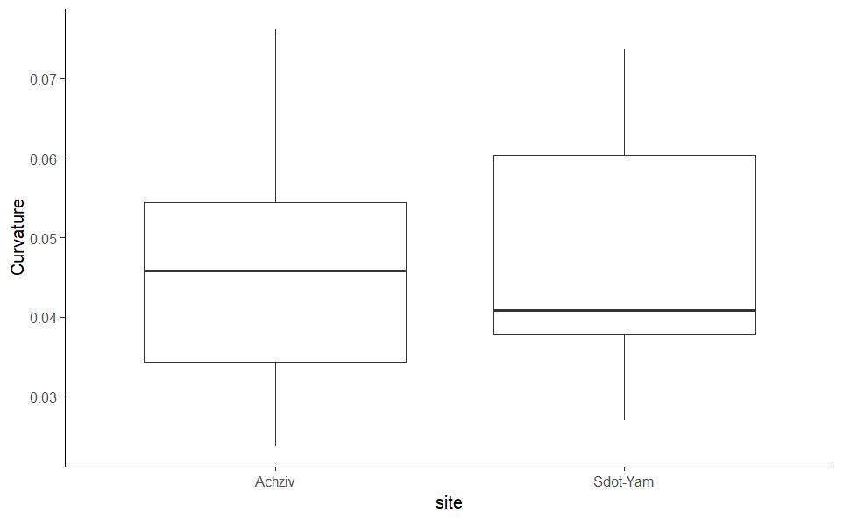
Curvature: how strongly the profile changes at the top of convex configurations and at the bottom of concave configurations (i.e. at the locations of local extrema)

